Slide 1


SMUX: Aveda Customer Analysis
(GROUP 1) CHEN YIMAN | KYAW ZAW LWIN | LAM YU HAY GLADWIN |WIDYA TANTIYA YUTIKA
ZHU FANGYUAN

Slide 2


Recap: Background
Pre-Covid | Post-Covid
High spend per transaction High purchase frequency Short return purchase interval | Lower spend per transaction Lower purchase frequency Higher return purchase interval
Declining Revenue
Problem Statement
1. How can we apply RFM Model to increase customers’ repeat purchases?
2. How can we reduce repeat purchase intervals of existing customers?
3. How can we increase the sales amount of each basket using cross-selling tactics?

Slide 3
Recap: Summary of Previous Analysis
RFM model – Split by sales channel then segment based on relative recency, relative frequency and relative monetary value (GMV)
RFM Segments: Champions, Loyalist, Potential Loyalist, Needs Attention, Churning, Churned
Positive return of investments despite giving out samples
Inconsistency in top selling products based on different perspectives
Top 2 Best seller based on revenue:
Invati advanced™ exfoliating shampoo light 1000ML (152$)
Invati advanced™ scalp revitalizer 150ML (72$)
Top 2 Best seller based on popularity in clients:
Rosemary mint purifying shampoo 250ML (21$)
Shampure™ nurturing shampoo 250ML (21$)
Differences in best sellers across different channels and different customer segments
There is a need to further segment our customers to understand them, to devise a more personalized marketing strategy rather than a one size fits all approach.

Slide 4
Today’s Agenda
Our Approach to Solve the Current Problem
Further Customer Segmentation
Choosing the higher priority segments to focus on
Personas
Marketing Strategy to Increase Sales
Creation of new bundle sets
Multi prong Recommendation System
Managing pricing discounts
Managing sample offerings
New Marketing Initiatives to Drive Sales
Aveda Subscription Plan
Aveda Affiliate Programme
Conclusion

Slide 5
A Strategic Approach to Increase Sales
Recency, frequency and Average Basket Sales can impact sales
Recency
How recent was last purchase?
Promotional price to disrupt buyer purchase timeline
Complementary product recommender to cross sell new products otherwise they would not have bought
Complementary product recommender to cross sell new products otherwise they would not have bought
Returning customers who received samples that found a new value proposition using the samples
Frequency
Total purchase orders
Average Basket Size
GMV per checkout
Promotional price that encourages buying more quantity and/or higher priced items
Increase ABS via upselling with bundle sets
Tools we can use to lift sales: 1) Product recommender 2) Promotional Price 3) Sample offerings 4) Bundle Sets

Slide 6
Priotising Customer Segments to Target
Retail GMV : ~$5.5mio Total Customer Size: 15733
Champions Size: 1224
Loyalist Size: 1055
Potential Loyalist Size: 4005
Needs Attention Size: 1707
Churning Size: 3383
Churned Size: 4359
Ecommerce GMV : ~$4.2mio Total Customer Size: 335
Champions Size: 24
Needs Attention + Churning Size: 56
Churned Size: 255
3rd Party MP GMV : ~$2.5mio Total Customer Size: 9073
Champions Size: 672
Loyalist Size: 455
Potential Loyalist Size: 809
Needs Attention + Churning Size: 790
Churned Size: 6347
Corporate GMV : ~$34k Total Customer Size: 199
Champions Size: 5
Loyalist Size: 20
Potential Loyalist Size: 122
Needs Attention + Churning + Churned Size: 52
Little GMV impact to focus on “Needs Attention + Churning” and “Churned” segments under eCommerce channel as the 311 customers only contribute to 4% of $4.2mio GMV
Difficult to ramp up marketing effort in 3rd party MPs due to 3rd party dependencies
Little GMV impact to focus on Corporate channel as it contributes insignificant GMV and its difficult to scale this channel
Retail channel contributes the highest GMV
Target increasing sales from ”Needs Attention” and “Potential Loyalist” segments first as it is: 1) Good segment size 2) Fastest to see any GMV impact

Slide 7



Deep Dive: Personas of Retail “Potential Loyalist”
The desperate “Hair Thinning” middle aged man
Name: John
1 past purchase Last purchase about 3 months Spent $288 in total Hair Care Needs: Experiencing hair loss
The very concerned “Damaged Hair” lady
Name: Ariane
3 past purchases Last purchase about 6 months Spent $517 in total Hair Care Needs: Damaged hair and dry hair
The mildly “Damaged Hair” first time buyer
Name: Helen
1 past purchases Last purchase about 2 months Spent $197 in total Hair Care Needs: Damaged hair and wants a healthy scalp
Notes:
The desperate “Hair Thinning” middle aged man – Potential Cluster 3
The mildly “Damaged Hair” first time buyer – Potential Cluster 2
The very concerned “Damaged Hair” lady– Potential Cluster 1

Slide 8



Deep Dive: Personas of Retail “Need Attention”
The impatient skeptical “Hair Thinning” man
Name: Boon Kiat
1 past purchase Last purchase about 6.5 months Spent $159 in total Hair Care Needs: Experiencing hair loss
The not too concerned “Damaged Hair” lady
Name: May
2 past purchases Last purchase about 7.5 months Spent $202 in total Hair Care Needs: Damaged hair
The “Dry hair” but not too concerned, price sensitive bulk buyer
Name: Lucy
2 past purchases Last purchase about 11 months Spent $352 in total Hair Care Needs: Dry hair
Notes:
The impatient Skeptical “Hair Thinning” man – Need Attn Cluster 1
The not too concerned “Damaged Hair” lady – need attn cluster 2
The “Dry hair” but not too concerned, price sensitive bulk buyer - – need attn cluster 3

Slide 9
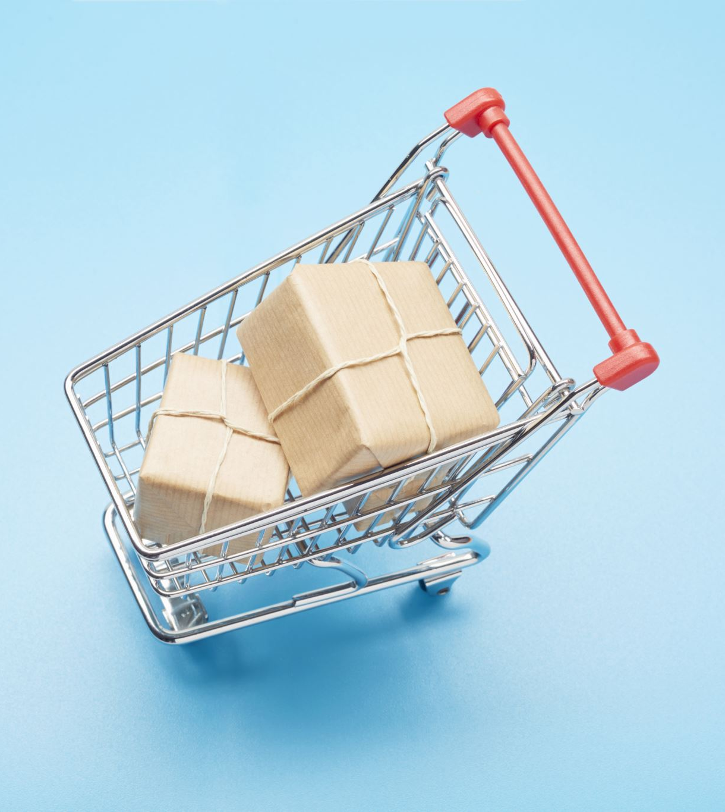
Market Basket Analysis (MBA)
MBA is a data mining & statistical technique used in retail & e-commerce to discover associations between products that are often purchased together by customers
The primary goal of MBA is to identify patterns & relationships in transaction data, such as customer purchase history & to determine which items tend to be bought in conjunction with others
This analysis can help retailers understand customer preferences, optimize pricing and promotion strategies, and increase revenue through cross-selling and upselling
Notes:
Market Basket Analysis (MBA) is a data mining and statistical technique used in retail and e-commerce to discover associations between products that are often purchased together by customers.

Slide 10
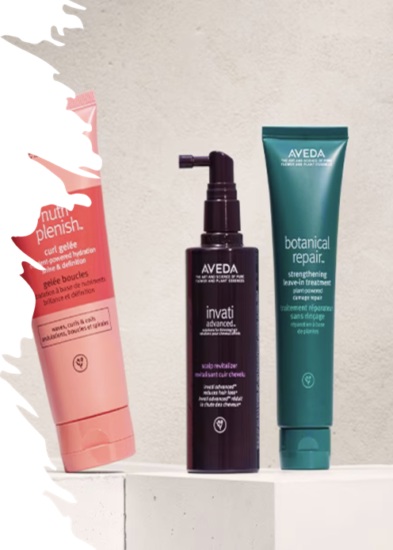
Apriori algorithm
A widely used method for performing Market Basket Analysis
It works by generating association rules that identify frequent item sets in transaction data
The parameters used for the Apriori algorithm are:
Support: This is the minimum threshold for an itemset to be considered frequent. It is typically defined as the percentage of transactions that contain a particular itemset.
Confidence: This parameter determines the strength of the association between items in an association rule. It's calculated as the percentage of transactions containing the antecedent (left-hand side) item where the consequent (right-hand side) item is also present.
Lift: Measures how much more likely the consequent is bought when the antecedent is bought compared to when it's bought without considering the antecedent. Lift values greater than 1 indicate a positive association.
Minimum Items per Rule: This parameter sets the minimum number of items in an association rule.

Slide 11
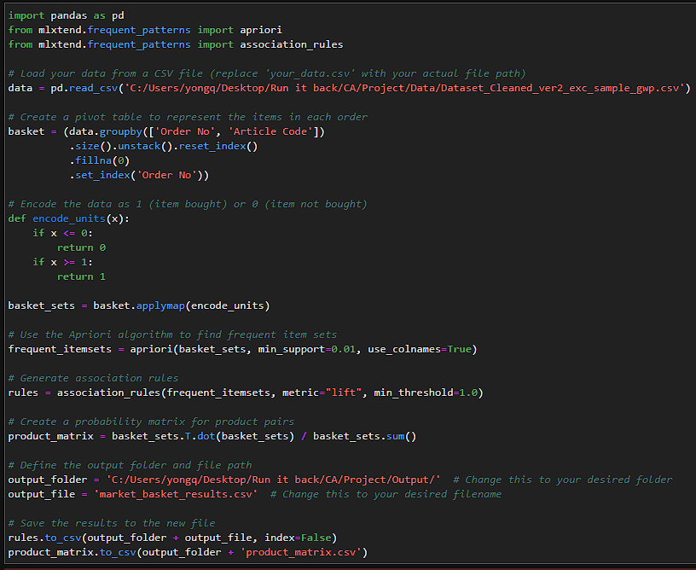
MBA using Apriori algorithm
Order number & Article code are the parameters used for this Market Basket Analysis
The minimum support is 0.01, the minimum threshold is 1.0 & the metric is the lift

Slide 12
Market Basket Analysis results
antecedents | consequents | antecedent support | consequent support | support | confidence | lift
frozenset({'A09A700000-1'}) | frozenset({'A1XG010000'}) | 0.0604 | 0.0739 | 0.0125 | 0.206 | 2.791
frozenset({'A1XG010000'}) | frozenset({'A09A700000-1'}) | 0.0739 | 0.0604 | 0.0125 | 0.169 | 2.791
frozenset({'AMFW010000'}) | frozenset({'A09A700000-1'}) | 0.1000 | 0.0604 | 0.0115 | 0.115 | 1.902
frozenset({'A09A700000-1'}) | frozenset({'AMFW010000'}) | 0.0604 | 0.1001 | 0.0115 | 0.190 | 1.902
frozenset({'A1XG010000'}) | frozenset({'AEY9010003'}) | 0.0739 | 0.06696 | 0.0102 | 0.138 | 2.056
frozenset({'AEY9010003'}) | frozenset({'A1XG010000'}) | 0.06696 | 0.0739 | 0.0102 | 0.152 | 2.056
frozenset({'A1XG010000'}) | frozenset({'AMFT010000'}) | 0.0739 | 0.0427 | 0.0111 | 0.149 | 3.502
frozenset({'AMFT010000'}) | frozenset({'A1XG010000'}) | 0.0427 | 0.0739 | 0.0111 | 0.259 | 3.502
frozenset({'AMFW010000'}) | frozenset({'A1XG010000'}) | 0.1001 | 0.0739 | 0.0121 | 0.121 | 1.633
frozenset({'A1XG010000'}) | frozenset({'AMFW010000'}) | 0.0739 | 0.1001 | 0.0121 | 0.163 | 1.633
Notes:
MBA 2 dp

Slide 13
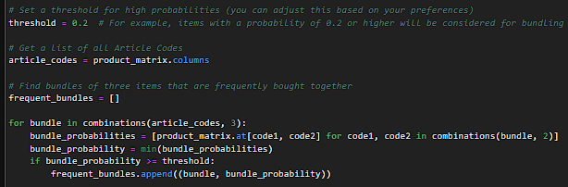
Product Probability Matrix code
The probability threshold is set to 0.2
While the number of items per bundle was set to 3 & 2

Slide 14
Product Probability Matrix
Article Code | A09A700000-1 | A0K6010000 | A0RF010000 | A0TK010000 | A139010000
A09A700000-1 | 1 | 0.0157 | 0.0372 | 0.0286 | 0
A0K6010000 | 0.00160 | 1 | 0.00429 | 0 | 0
A0RF010000 | 0.0139 | 0.0157 | 1 | 0 | 0
A0TK010000 | 0.000533 | 0 | 0 | 1 | 0
A139010000 | 0 | 0 | 0 | 0 | 1
A13F010000 | 0 | 0 | 0 | 0 | 0.0357
A14G010000 | 0.00320 | 0.00524 | 0.00429 | 0 | 0
A14H01J000 | 0.00533 | 0 | 0.00572 | 0 | 0
A14Y010000 | 0.0107 | 0 | 0.00715 | 0 | 0.0357
Notes:
2 dp

Slide 15
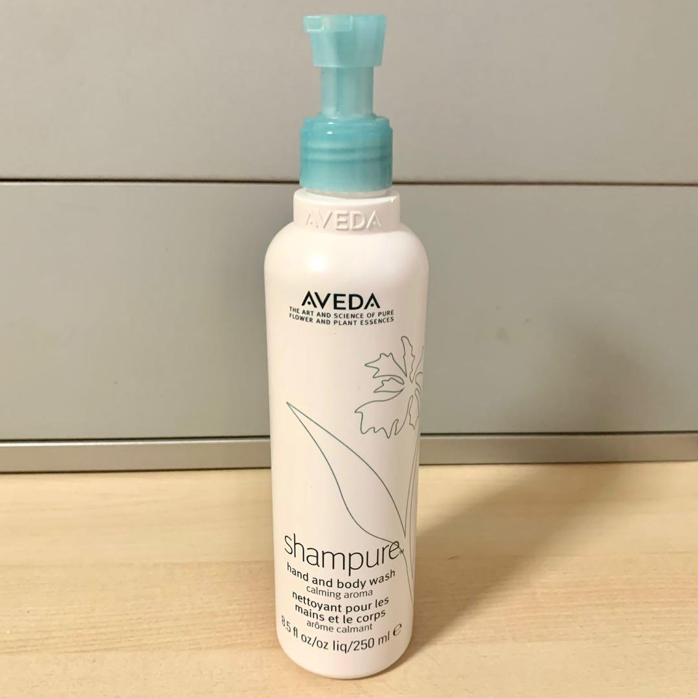
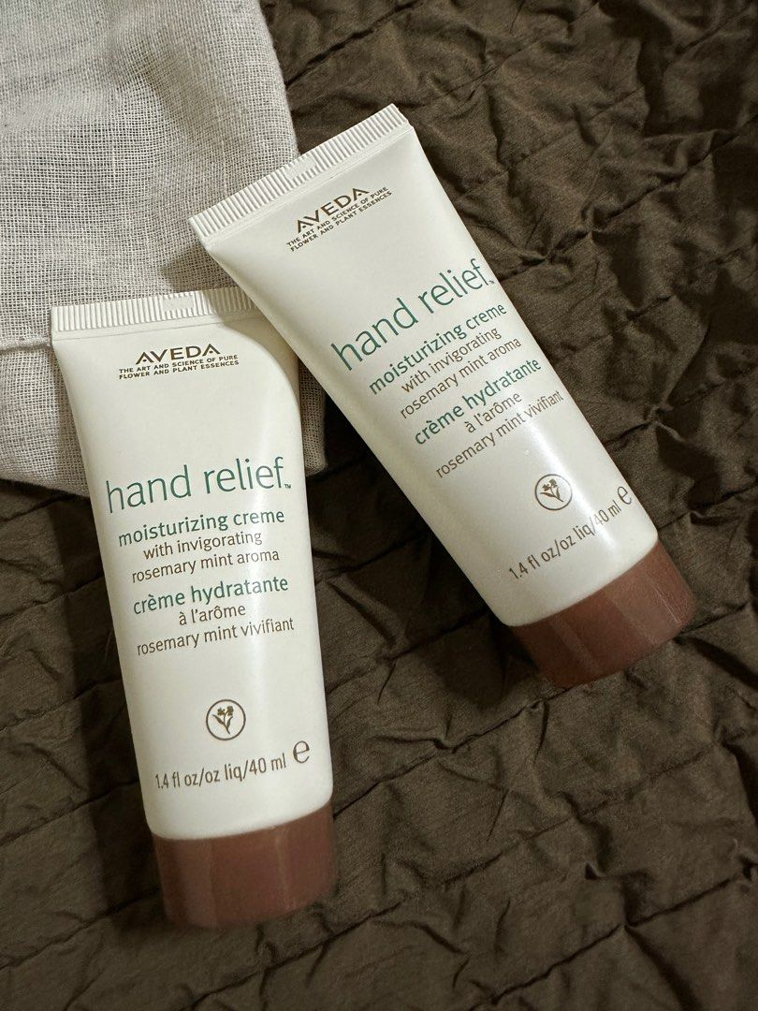
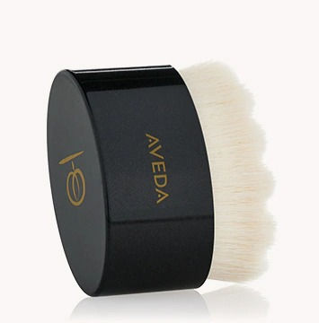
Recommended Bundles to increase RFM (Retail)
Product 1 | Product 2 | Product 3 | Probability
AVH SHAMPURE HAND & BODY WASH 250ML | AVH BEAUTIFYING HAND RELIEF 40ML TUBE | AVH TLS FACIAL DRY BRUSH | 0.519
AVH RM H/B WASH 250ML | AVH BEAUTIFYING HAND RELIEF 40ML TUBE | AVH TLS FACIAL DRY BRUSH | 0.429
AVH SS EXFOLIATING SCALP TREATMENT 150ML | AVH SS OVERNIGHT SCALP RENEW SERUM 50ML | AVH SCALP SLTN STIMULATG SCALP MASSAGER | 0.394
AVH SS EXFOLIATING SCALP TREATMENT 150ML | AVH SS BALANCING SHAMPOO 200ML | AVH SS REPLENISHING CONDITIONER 200ML | 0.393
AVH LITER PUMP | AVH SS BALANCING SHAMPOO 1000ML | AVH SS REPLENISHING COND 1000ML | 0.333
AVH Shampure Hand & Body Wash 250 ml
AVH Beautifying Hand Relief 40 ml Tube
AVH TLS Facial Dry Brush
Notes:
Compare existing bundles (collections), can go beyond collections like our top bundle (shampoo, hand tube, brush)

Slide 16
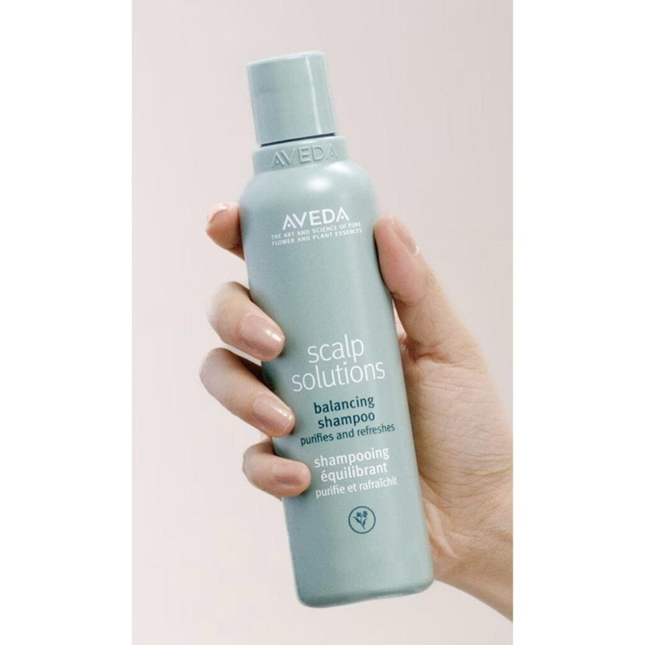
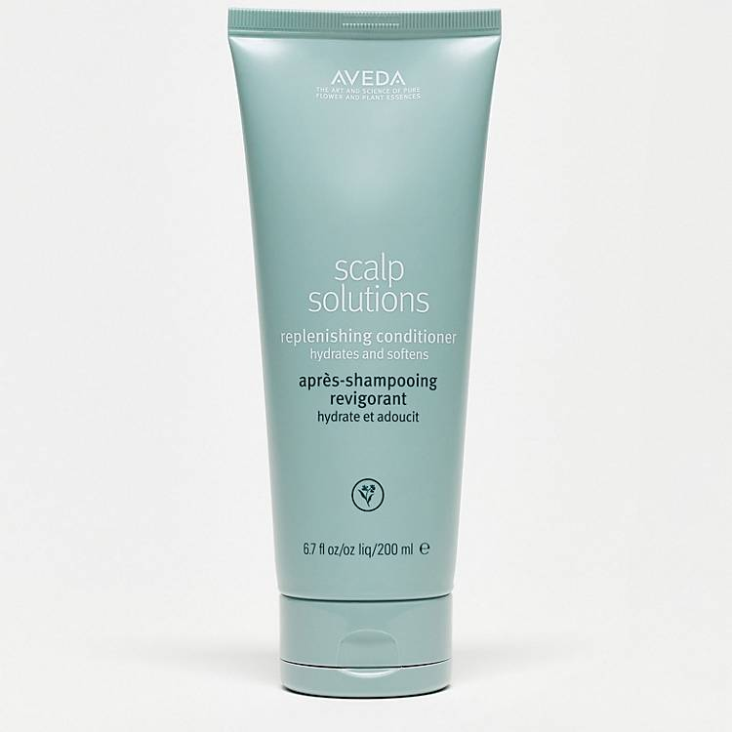
Recommended Bundles to increase RFM (Retail)
Product 1 | Product 2 | Probability
AVH SS BALANCING SHAMPOO 200ML | AVH SS REPLENISHING CONDITIONER 200ML | 0.833
AVH COLOR CTRL SHAMP 10ML/.34FLOZ | AVH COLOR CNTL COND 10ML/.34FLOZ | 0.832
AVH 19 ROSEMARY M PURIFY SHAMPOO 250ML | AVH SS BALANCING SHAMP 1000ML | 0.789
AVH 19 ROSEMARY M PURIFY SHAMPOO 250ML | AVH SS REPLENISHING COND 1000ML | 0.778
AVH RM H/B WASH 250ML | AVH INVATI ADV LITRES | 0.681
AVH SS Replenishing Conditioner 200 ml
AVH SS Balancing Shampoo 200 ml
Notes:
Compare existing bundles (collections), can go beyond collections like our top bundle (shampoo, hand tube, brush)

Slide 17
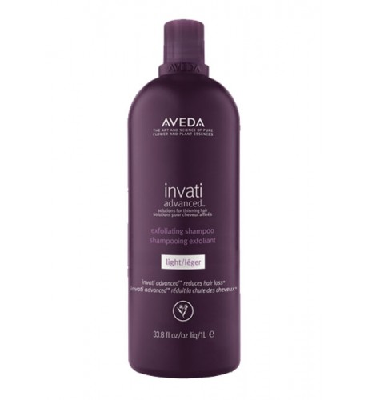
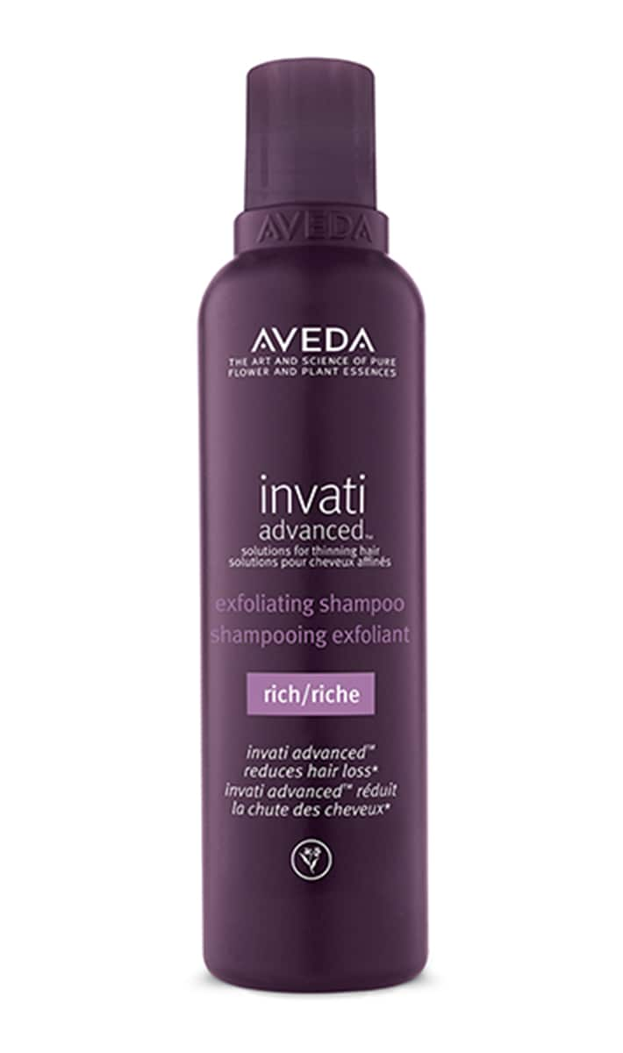
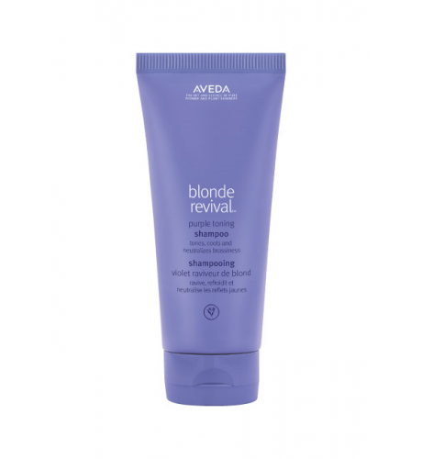
Recommended Bundles to increase RFM (E-commerce)
Product 1 | Product 2 | Product 3 | Probability
AVH INVATI ADV EXF SHAMP LIGHT 1000ML | AVH INVATI ADV EXF SHAMP RICH 200ML | AVH BLONDE REVIVAL SHAMP 200ML | 0.933
Product 1 | Product 2 | Probability
AVH INVATI ADV EXF SHAMP LIGHT 1000ML | AVH INVATI ADV EXF SHAMP RICH 200ML | 0.933
AVH Invati ADV EXF Shamp Light 1000 ml
AVH Invati ADV EXF Shamp Rich 200 ml
AVH Blonde Revival Shamp 200 ml

Slide 18
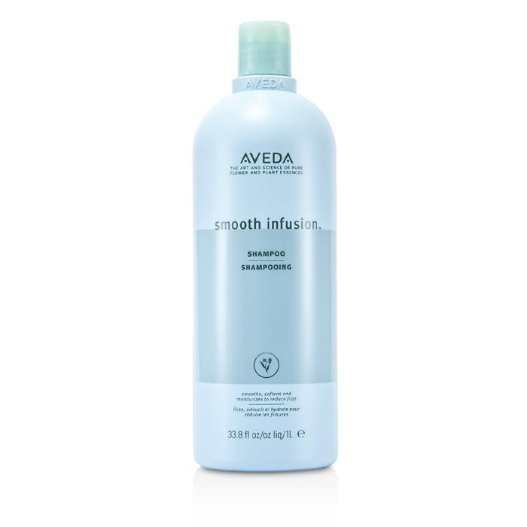
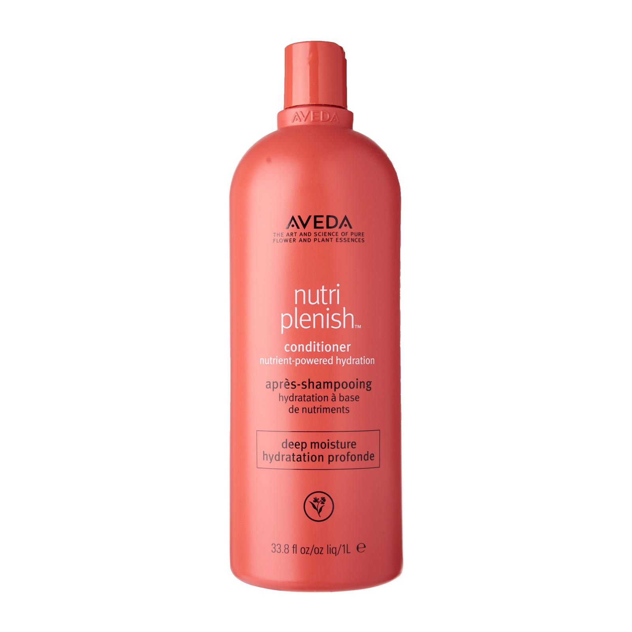
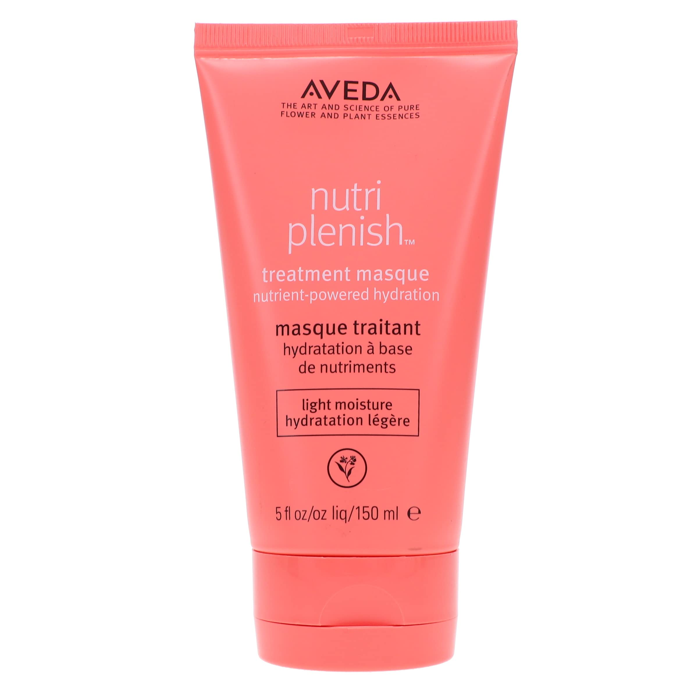
Recommended Bundles to increase RFM (Corp Sales)
Product 1 | Product 2 | Product 3 | Probability
AVH SMOOTH INFUSION SHMP 1000ML | AVH NUTRIPLENISH COND LT 1000ML | AVH NUTRIPLENISH MASK LGT 150ML | 0.333
Product 1 | Product 2 | Probability
AVH SMOOTH INFUSION SHMP 1000ML | AVH NUTRIPLENISH COND LT 1000ML | 0.333
AVH Smooth Infusion Shmp 1000 ml
AVH Nutriplenish Cond LT 1000 ml
AVH Nutriplenish Mask LGT 150 ml

Slide 19
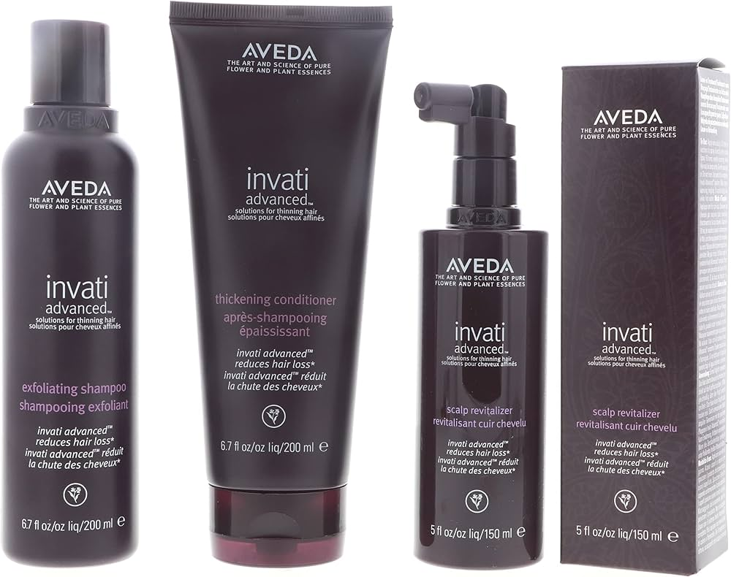
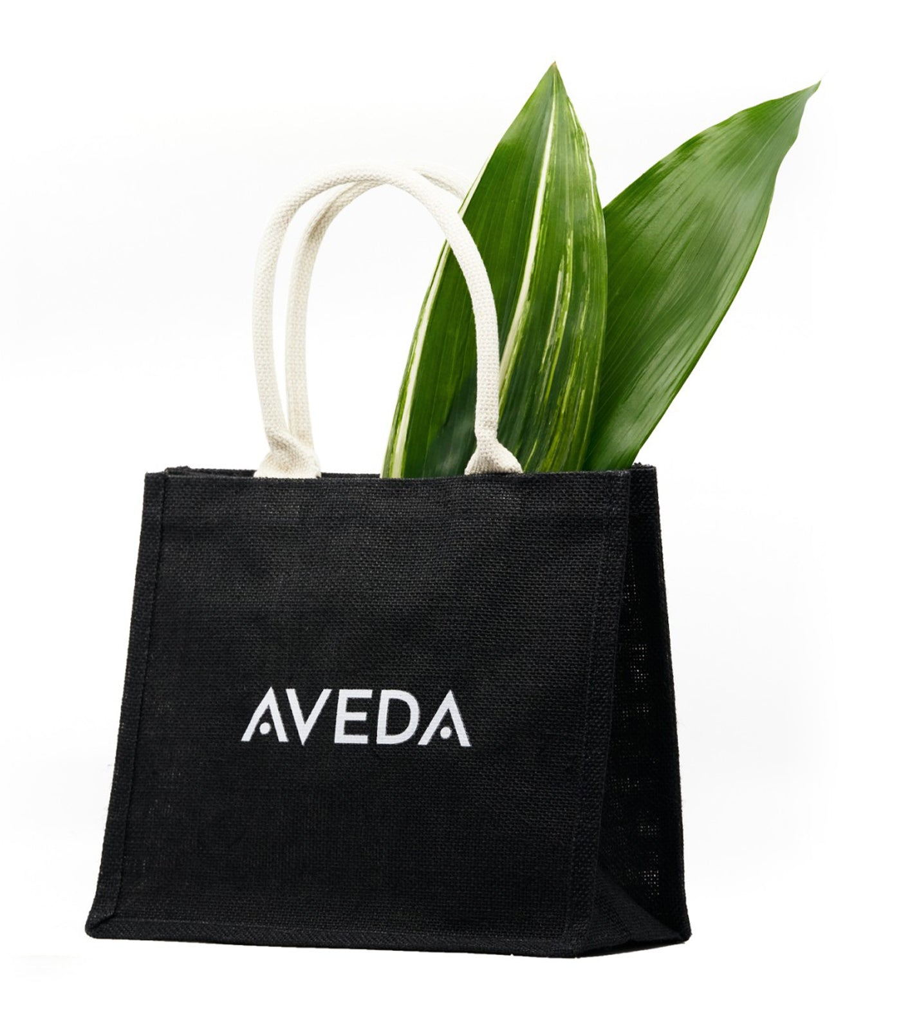
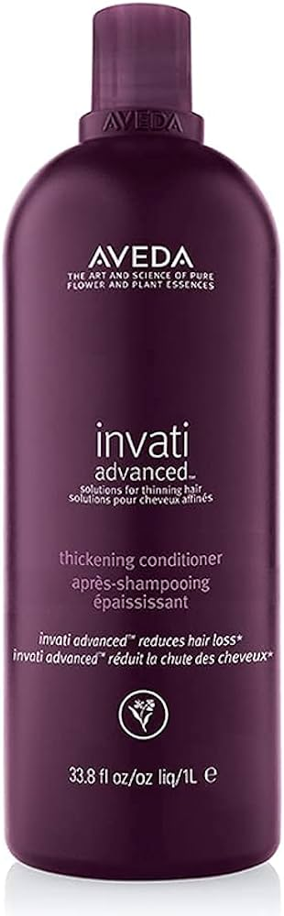
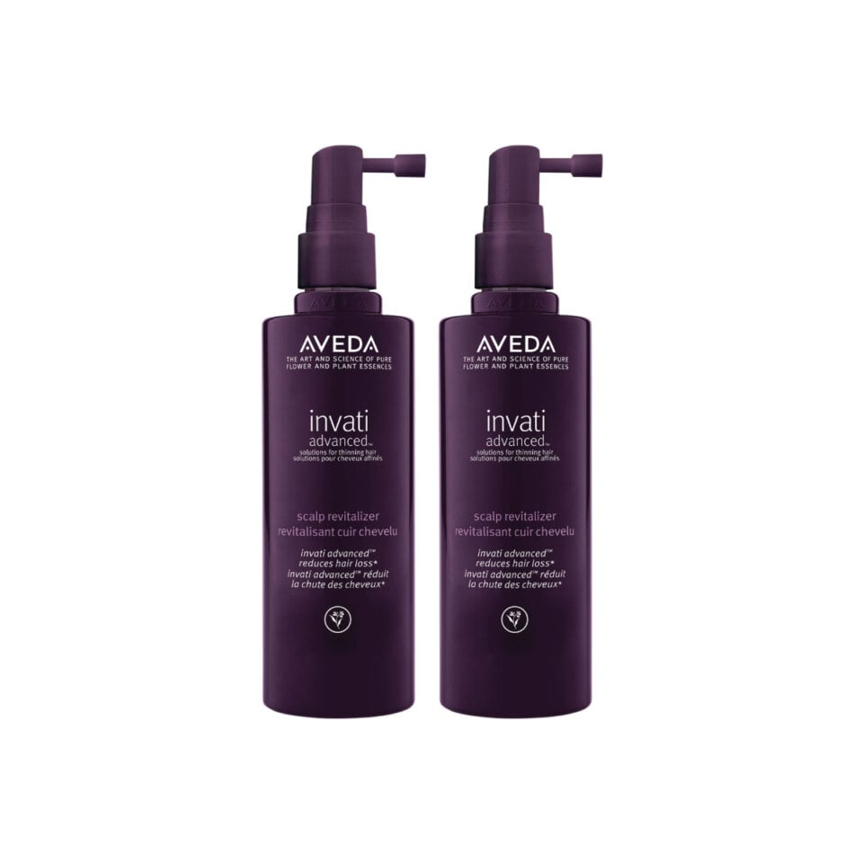
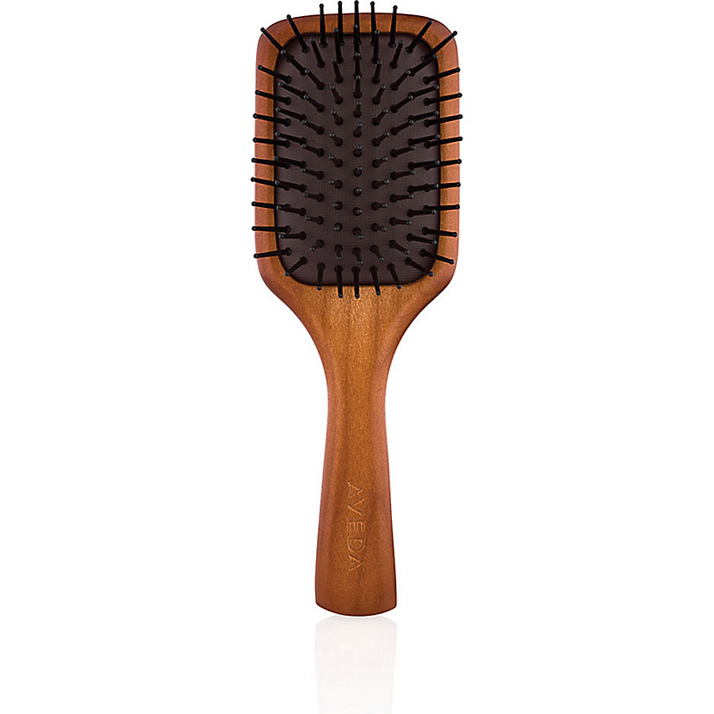
Recommended Bundles to increase RFM (3rd Party Marketplaces)
Product 1 | Product 2 | Product 3 | Probability
AVH ORGANIC TOTE BAG | AVH INV REVITALIZER DUO (OL) | AVH INV COND 1L + LE MINI PADDLE | 0.704
Product 1 | Product 2 | Probability
AVH ORGANIC TOTE BAG | AVH INV SP LT 1L + COND + REVIT 10ML X 2 | 0.969
AVH INV SP LT 1L + Cond + Revit 10ML X 2
AVH Organic Tote Bag
AVH INV Revitalizer Duo (OL)
AVH INV Cond 1 L
Le Mini Paddle

Slide 20



Recommendation System
Recommendation system provides personalized suggestions to users based on their past behavior and preferences
&
RECENCY
FREQUENCY
Offer valuable and relevant suggestions (CUSTOMER EXPERIENCE) making customers are more likely to return and engage more recently
MONETARY
Entice customer to make ADDITIONAL PURCHASES or COMPLEMENTARY ITEMS
Notes:
What is a recommendation system?
Recommendation system provides personalized suggestions to users based on their past behavior and preferences.
How it help to increase RFM?
In term of recency and frequency
With personalizes recommendation system that offer valuable and relevant suggestions, customer experience enhances which lead to customer wanting to come back /engage more recenly
In term of monetary, with recommendation system we can recommend complementary items and this leads customers to make additional purchases.

Slide 21
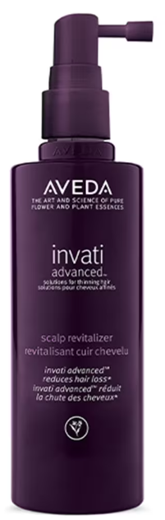
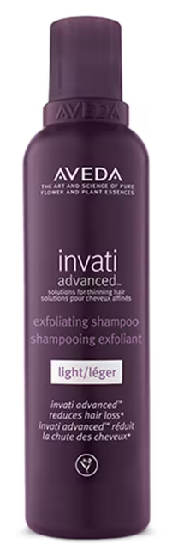
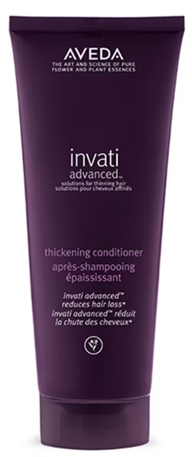
Recommendation System
For New Customer
Recommend best sellers based on sales channel
Only recommend main business line (haircare) and single item (not a set)
Recommend smaller size of best sellers
Thinning Hair Solution
Sales Channel | Best Seller | Remarks
Retail | AVH INVATI ADV SCALP REVITAL 150ML AVH INVATI ADV EXF SHAMP LIGHT 200ML AVH INVATI ADV THICK COND 200ML | INVATI Collection
E-commerce Stores | AVH 19 ROSEMARY M PURIFY SHAMPOO 250ML AVH 19 SHAMPURE SHAMPOO 250ML AVH INVATI ADV EXF SHAMP LIGHT 200ML | Shampoo
Corp Sales | AVH 19 ROSEMARY M PURIFY SHAMPOO 250ML AVH INVATI ADV EXF SHAMP LIGHT 200ML AVH 19 SHAMPURE SHAMPOO 250ML | Shampoo
3rd Party Marketplaces | AVH 19 ROSEMARY M PURIFY SHAMPOO 250ML AVH INVATI ADV EXF SHAMP LIGHT 200ML AVH PRMS SCALP CLNSR 150ML | Shampoo and Scalp Cleanser
Notes:
For new customer, since we do not know the customer preferences, we can only recommend the best seller.

Slide 22
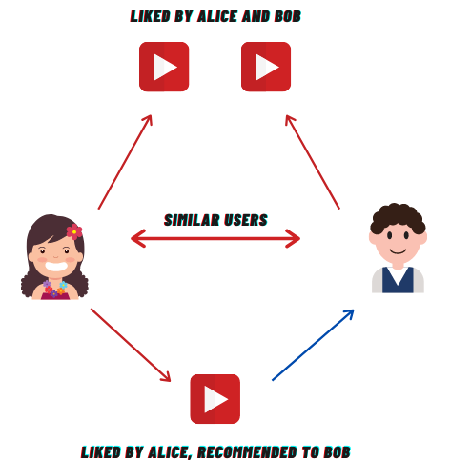
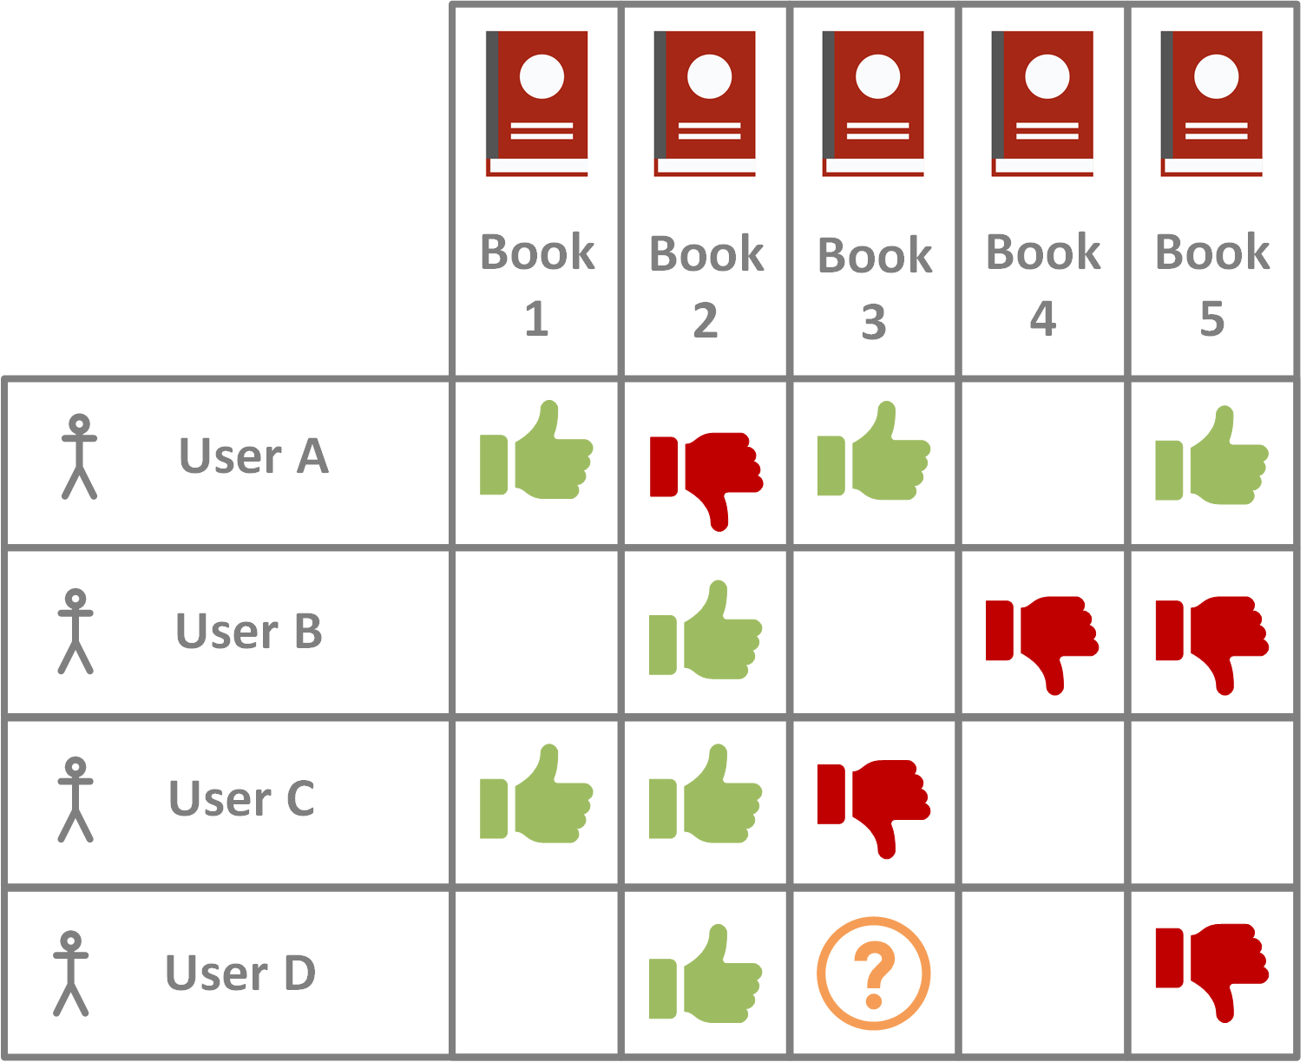
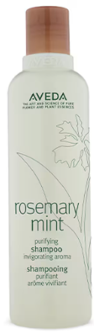
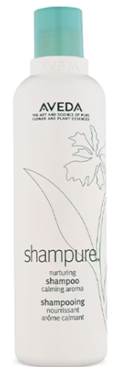
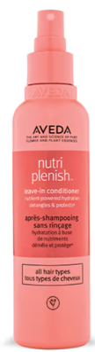

Recommendation System
For Existing Customer (User – Item Collaborative Filtering)
INVATI SHAMPOO
ROSEMARY SHAMPOO
Notes:
What is user – Item Collaborative Filtering?
It is popular technique used in recommendation systems to generate personalized recommendations based on the behavior and preferences of both users and items.

Slide 23

Recommendation System
For Existing Customer (User – Item Collaborative Filtering)
Problem?
No data about Customer Ratings on items
How we define the ratings?
Repurchase count
Assumption:
Items without repurchase are assumed to be “No Rating”
1
2
3
4
5
Notes:
How do we define the ratings or indicator that someone likes the products?

Slide 24

Recommendation System
For Existing Customer (User – Item Collaborative Filtering)
K-Nearest Neighbors Baseline
Finding the most similar users to a target user based on their past interactions.
The "K" in KNN represents the number of nearest neighbors to consider.
Parameters:
K = 10
Similarity Matrix: Cosine
Min-Support: 10
Best Model RSME : 0.536 (Ratings scale 1-5)
Machine Learning
Customers without repeat purchase will not get any recommendation from this method.
Notes:
K : number of neighbors to consider
Similarity Matrix

Slide 25
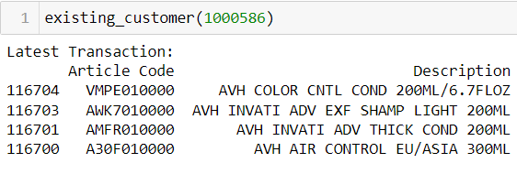
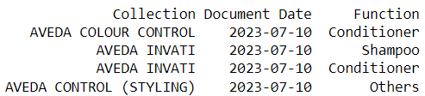
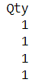
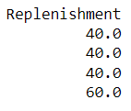
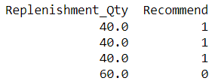

Recommendation System
For Existing Customer (Latest Purchase History)
Replenishment depends on quantity sold:
Qty sold>10 : B2B (Replenishment_Qty = Replenishment)
Qty sold<=10 : B2C (Replenishment_Qty = Replenishment*Qty)
1 x
= 10ML & 2 days once
= 150ML /mth
Customers who recently shopped may not get any recommendation from this method.

Slide 26
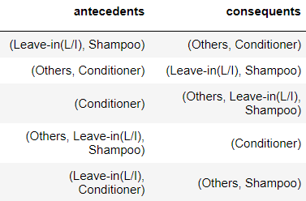
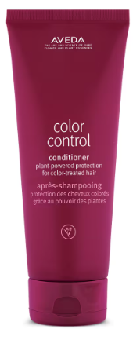
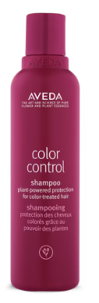
Recommendation System
For Existing Customer (Latest Purchase History)
Recommend Complementary Items
Market Basket Analysis (Frequently bought together function)

Slide 27
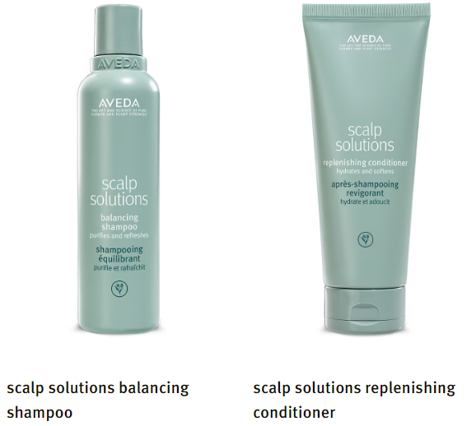
Recommendation System
Next Item on Cart
Recommend Complementary Items
Market Basket Analysis (Frequently bought together items)
Notes:
Demo Customer ID:
Collaborative Filtering: Customer ID 1000586

Slide 28
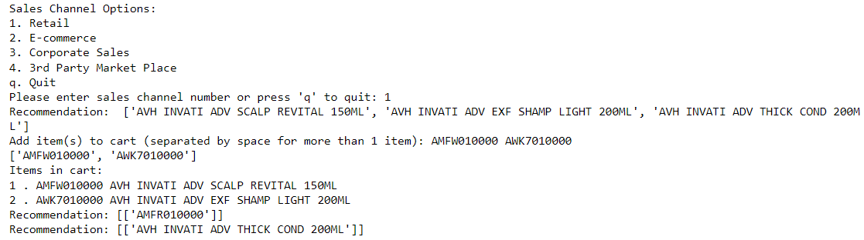
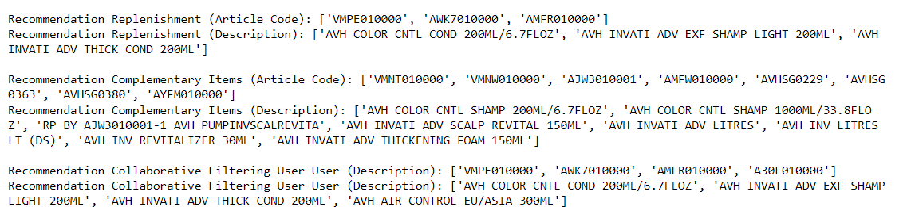
Recommendation System
Notes:
Demo Customer ID:
Collaborative Filtering: Customer ID 1000586

Slide 29
How Recommendation System can be implemented in Retail Channel Stores?
Customer Identification:
By asking for their phone number or scanning their app QR code
Access Customer Data:
Retrieve the customer's past purchase history and preferences from the store's database.
Analyze Past Purchases:
The salesperson reviews the customer's past purchases and product preferences
The salesperson utilizes the recommendation system and provides personalized product recommendations

Slide 30
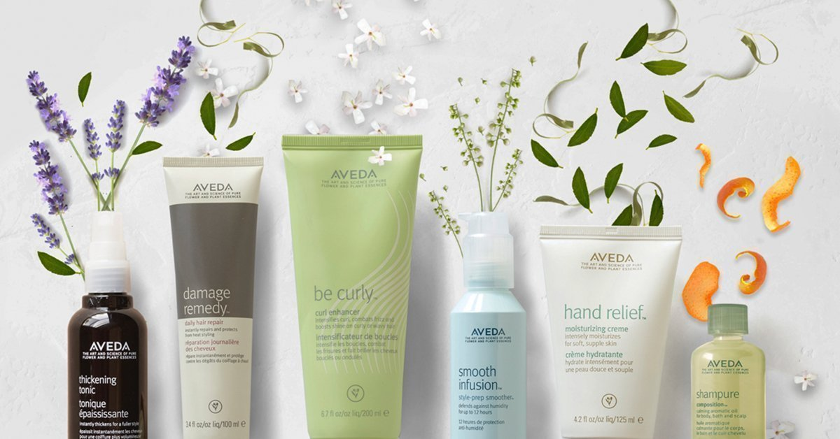
Discount Analysis
Approach
Objective
Assess the impact of discount strategies on various aspects of Aveda's performance, including sales, customer behavior, and profitability.
Overview of Discount:
How much we gave out?
Does Discount impact frequency?
ANOVA Test difference of Discount
Correlation Discount vs Frequency
Discount : Frequency & ABS
Which one is more efficient？
Does Discount impact ABS?
Comparison Customers segmentations
Discount they received VS frequency
Discount they received VS ABS
Notes:
The objective of this discount analysis is to assess the impact of discount strategies on various aspects of Aveda's performance, including sales, customer behaviours, and profitability.
Let's start by understanding the extent of the discounts Aveda has offered. We'll analyse the total value of discounts provided and identify the distribution of these discounts among different products and customer segments.
We will also compare the efficiency of different discount strategies. Specifically, we'll evaluate the effectiveness of different discount levels and determine which one has a more significant impact on key performance indicators.
Discount Analysis 1: Does Discount Impact Frequency?
We aim to assess whether the discounts Aveda offers have an impact on customer visit frequency.
Discount Analysis 2: Does Discount Impact ABS (Average Basket Size)?
This analysis will explore the relationship between the discounts provided by Aveda and the Average Basket Size (ABS) of customer purchases.

Slide 31
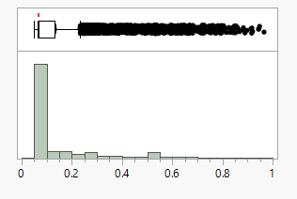
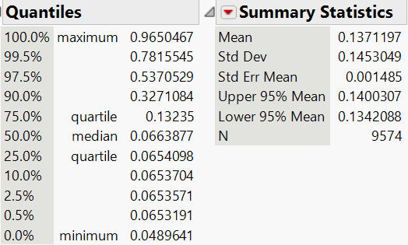
Overview of Discount How Much Discount We Gave Out?
Observations of data distribution:
The highest proportion of customers who benefit from a 10% discount
The second highest proportion of customers who benefit from a 40% discount
Discount
The majority of customers received discounts, with the highest proportion enjoying either a 10% discount (ranging from 5% to 15%) or a 40% discount (ranging from 35% to 45%)

Slide 32
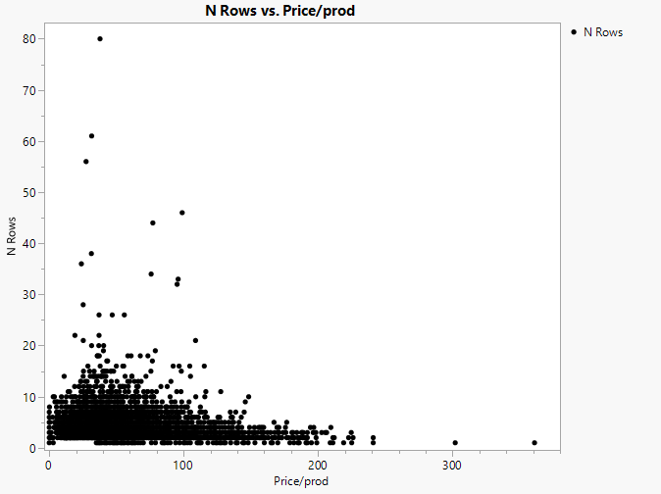
Discount Analysis Does Discount impact purchase frequency?
200~300 High spenders : exhibit a lower frequency of purchase, buy expensive items less frequently.
100~200 moderate spenders : show a decreasing trend in purchase frequency as the price per product increases.
Low spender 0～100: divide horizontally
A+: frequency above 50
A: frequency between 20 and 50
B: frequency below 20
Low Spender
A+
A
Moderate Spender
B
High Spender
X-axis: average price per product = Total net Price/number of product
Y-axis: frequency = number of orders each customer conducted
Notes:
Does offering discounts affect customer purchase frequency?
We plot all customers on this scatter plot, Every point on the scatter plot represents a distinct customer, with a unique combination of a consuming frequency and the price per product
The average price of each product purchased by a customer is a key metric in customer analysis that can provide valuable insights into their preferences and consuming power
Preference: The average price of each product reflects a customer's product preferences. If a customer consistently purchases higher-priced items, it suggests they have a preference for quality, brand, or features associated with more expensive products. On the other hand, if a customer tends to buy lower-priced items, it may indicate a preference for cost-effectiveness or value.
Consuming Power: The average price of products bought by a customer is an indicator of their consuming power or purchasing capacity. Customers with a higher average product price are typically seen as having more economic resources and greater spending power. They can afford to invest in pricier items. Conversely, customers with a lower average product price may have limited financial resources or choose to be more frugal in their spending.
By analyzing the average price of products purchased by customers, Aveda can tailor their discount programs to better cater to the preferences and spending capabilities of different customer segments. This information can help in optimizing product assortment and pricing strategies to meet the diverse needs of their customer base.
Let’s look at the scatter plot
In this specific scatter plot, the X-axis is used to categorize customers into three spending categories based on the value of their spending per product:
Low Spenders (PPP Below 100 & FREQ below 20):
Customers falling to the left of X = 100 are categorized as "Low Spenders." These individuals have an average spending on each product below 100
For low spenders, we segmented again by purchase frequency, a noteworthy trend emerges. Specifically, for customers with a frequency of below 20, the purchase frequency tends to increase as the price per product increases, up to a point, after which it starts to decrease.
Conclusion:
Low spenders with a purchase frequency below 20 , As the price per product increases, their purchase frequency rises, indicating a willingness to invest in higher-priced items. However, this increase in frequency reaches a peak at a certain price point, after which their purchase frequency begins to decrease. This suggests that there is an optimal price range that maximizes their buying frequency.
Suggestion:
Identify the Optimal Price Range:
Lets Analyse data to determine the specific price range at which low spenders reach their peak purchase frequency, we can find all products after discount price fall in 20 ~40, or give discount to make popular product (eg, the product A,B bought frequently) price fall in 20~40 ,the sweet spot for these customers.
Low Spenders (PPP Below 100 & FREQ above 20):
For low spenders segmented by purchase frequency above 20, Unlike low spenders with lower frequencies, the purchase frequency does decrease as the price per product increases. Instead, this segment exhibits random purchases, and the number of customers in this category is very limited. It's worth delving deeper into their behaviours to understand their unique characteristics and preferences.
Suggestion:
Give Product Diversification:
Ensure a diverse product offering within the optimal price range, providing low spenders but high frequency with choices and variety that keep them engaged.
Cross-Selling Opportunities:
Explore cross-selling strategies to encourage the purchase of complementary products within the optimal price range. Bundling or recommending related items can lead to higher price per product and ABS
2.Moderate Spenders (100~200): Customers falling in the range of X = 100 to X = 200 are classified as "Moderate Spenders."
For moderate spenders, a noteworthy trend is that as the price per product increases, their purchase frequency tends to decrease. This indicates that providing more substantial discounts may actually lead to reduced purchase frequency among this customer segment.
3. High Spenders (200+): Customers to the right of X = 200 are considered "High Spenders." These customers consistently spend above 200 in the given context.
While high spenders possess considerable purchasing power and exhibit a preference for expensive products, they are a small and infrequent customer segment.
Suggestion:

Slide 33
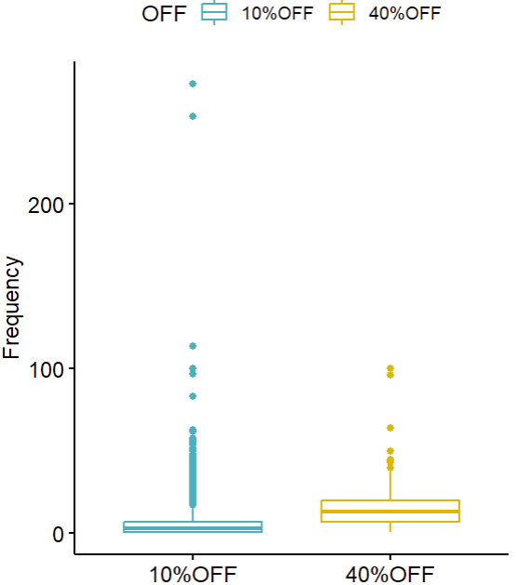
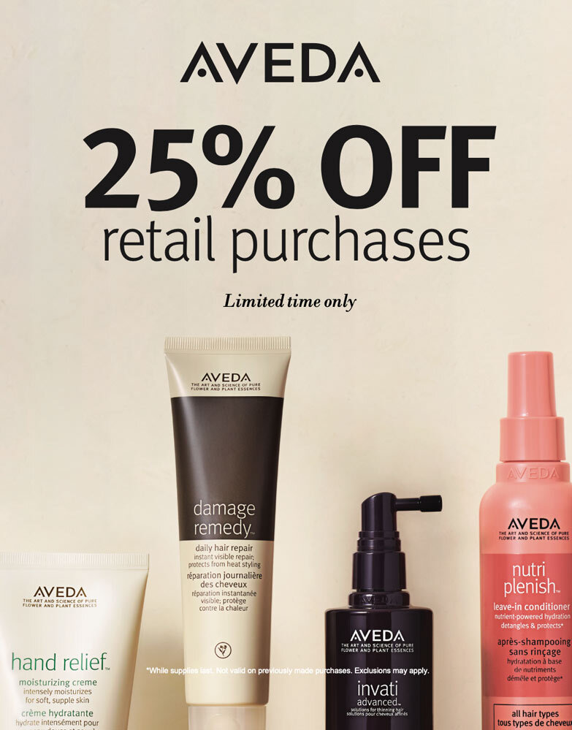
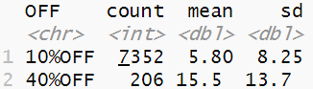
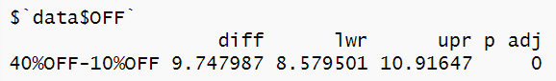
Overview of Discount Which Discount is more efficient? 10% or 40%?
10
Conclusion: offering a 40% discount is more effective at boosting customer visit frequency compared to a 10% discount.
Aveda may consider adjusting discount strategies to leverage the higher discount level for increased customer engagement and visit frequency
Notes:
The ANOVA (Analysis of Variance) test is a statistical method used to compare the means of multiple groups or treatments to determine if there are significant differences among them. In our test, we want to assess the effectiveness of two discount levels, 10% and 40% off, at boosting customer visit frequency.
**Analysis Objective:** Determine which discount, 10% or 40% off, is more effective at increasing customer visit frequency.
**Results Summary:**
- **40% - 10% Difference:** The difference in visit frequency between the 40% off and 10% off groups is 9.747. This indicates that, on average, customers who received a 40% discount visited more frequently than those with a 10% discount.
- **Level of Significance (LOR):** The level of significance is 8.57. This value helps determine whether the differences observed in visit frequency between the two discount groups are statistically significant. A higher LOR suggests stronger evidence of a significant difference.
- **Effect Size (Ups):** The effect size is 10.9. This measures the practical significance of the difference in visit frequency between the two discount groups. A higher effect size suggests a larger and more meaningful impact of the discount on visit frequency.
Here is Data Analysis:**
- **10% off Group:**
- Count (Number of Customers): 7352
- Mean (Average Visit Frequency): 5.8
- Standard Deviation (Variability in Visit Frequency): 8.25
- **40% off Group:**
- Count (Number of Customers): 206
- Mean (Average Visit Frequency): 15.5
- Standard Deviation (Variability in Visit Frequency): 13.7
**Interpretation:**
The ANOVA results indicate that there is a substantial difference in visit frequency between the two discount groups. Customers who received a 40% discount visited more frequently on average compared to those who received a 10% discount. The effect size (Ups) of 10.9 suggests that this difference is practically significant and not just a result of chance. The level of significance (LOR) of 8.57 further supports the conclusion that the difference is statistically significant.
**Conclusion:**
Based on the ANOVA test results, it can be concluded that offering a 40% discount is more effective at boosting customer visit frequency compared to a 10% discount. Businesses may consider adjusting their discount strategies to leverage the higher discount level for increased customer engagement and visit frequency.

Slide 34
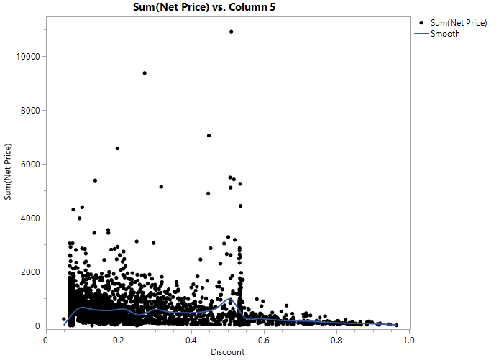
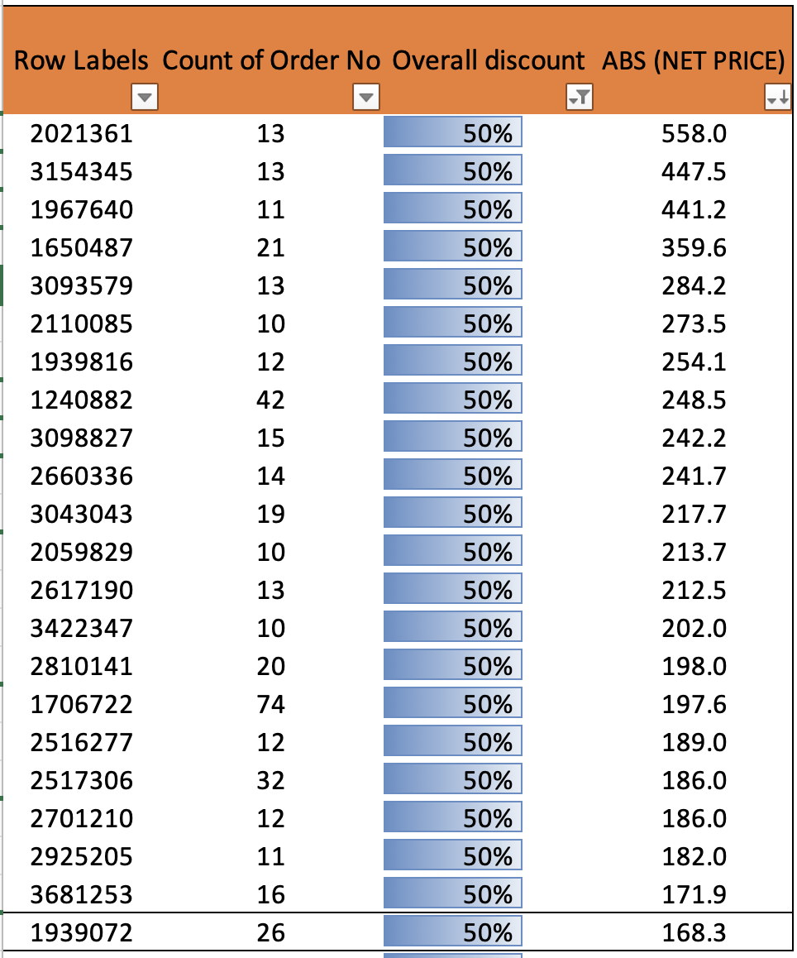


Discount Analysis DISCOUNT VS ABS
Left side
Right side
Every distinct customer, with a unique combination of a discount percentage and the total net price of all their orders
X-axis: Discounts received by each customer
Y-axis: Total net expenditure by each customer
The smooth line reached its peak for the total net sum with a 50% discount
Dots on the left side of the peak point: noticeable positive correlation between the total net price and the discount.
Dots on the right side of the peak point customers who received excessively high discounts, resulting in low sales/sum net price
Notes:
**Conclusions:**
1. **Optimal Discount Level:** The scatter plot indicates that the total net expenditure by customers tends to reach its peak at a 50% discount. This suggests that, on average, a 50% discount is the most effective in maximizing customer spending.
2. **Excessive Discounts:** Customers on the right side of the peak point, who received excessively high discounts, did not result in substantial growth in sales or total net price. This indicates that offering extremely deep discounts may not always yield a proportional increase in spending, and businesses should be cautious about giving away too much margin.
3. **Positive Correlation:** On the left side of the peak point, there is a noticeable positive correlation between the total net price and the discount. This suggests that customers are more likely to spend more when they receive a discount, even though this correlation may diminish as the discount level increases beyond the optimal point.
**Recommendations:**
1. **Optimize Discount Strategy:** Based on the scatter plot data, consider adjusting discount strategy to focus on the 50% discount range as it appears to be the most effective. However, we should also ensure that discounts do not go beyond this point, as excessive discounts may not yield a significant increase in spending.
2. Segment customer base and tailor discount offers to different customer segments. Customers who respond well to discounts can receive offers in the optimal discount range, while others may receive alternative incentives or promotions.
3.Review Aveda’s product assortment to ensure that it complements discount strategy. High-quality and popular products can be paired with discounts to maximize the impact on spending.
4. Maintain a balance between discounting and profit margins. While discounts are essential for attracting customers, they should not erode profitability.
By drawing insights from the scatter plot and implementing these strategies, Aveda can optimize their discount, product, and customer engagement strategies to maximize revenue while maintaining healthy profit margins.

Slide 35

Sample/GWP Analysis
Objectives
Approach
Step 1 Building customer loyalty
ANOVA Test difference of Frequency
Correlation Test of Samples/GWP vs Frequency
Step 2 Locating sample-sensitive customers
Comparison between Sample vs GWP
Customers sensitive to samples
Customers bought products from the same collection
Step 3 Locating effective samples
Those given out to customers with high purchase frequency

Slide 36
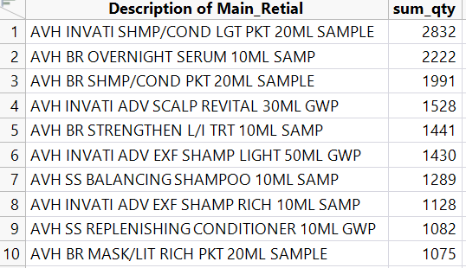

Overview of Sample and GWP
Mostly given out: Invati shampoo/conditioner light pocket 20 ML
27305 of 66 Samples & GWP were given out
…
Orders/day
More and more Samples and GWP were given out over time
Generally, the more orders per day, the more Samples and GWP are given out
No. of Samples and GWP/day
Notes:
For the sample product analysis, we excluded Gift With Purchase.
Every month Aveda gave out some samples, however the quantity of sample products distributed experienced a substantial surge from Oct 2021 and peaked in Dec 2021, significantly surpassing all previous distribution levels.

Slide 37


Step 1: Building customer loyalty
Does giving out samples/GWP have a relationship with customer purchase frequency (New customers excluded)?
Objectives
SMP vs. Avg_Frequency
GWP vs.
Avg_Frequency
ANOVA Test result:
There is a statistical significance that the customers who have ever received samples/gifts come back more frequently.
Received Samples?
Yes->Avg Frequency = 11
No-> Avg Frequency = 4
Received GWP?
Yes->Avg Frequency = 12
No-> Avg Frequency = 5
diff lwr upr p adj
Y-N 6.738243 6.456744 7.019742 0
SMP count mean sd
<chr> <int> <dbl> <dbl>
1 N 7924 3.73 4.36
2 Y 7732 10.5 12.0
diff lwr upr p adj
Y-N 8.012912 7.721211 8.304613 0
GWP count mean sd
<chr> <int> <dbl> <dbl>
1 N 10351 4.35 4.88
2 Y 5305 12.4 13.5

Slide 38







Step 1: Building customer loyalty
Is giving sample or GWP more associated in with customer frequency?
Observations of data distribution:
50% of customers get samples
Only 25% of customers get GWP
Correlation test result:
With statistical significance, GWP and Samples both have a significantly positive association with the customers’ purchase frequency
Giving GWP has a higher association with the frequency than samples

Slide 39







Step 1: Building customer loyalty
As GWP is more associated than samples. As only 25% of customers have received GWP, Aveda can explore giving GWP over samples to increase other customers’ loyalty.
However, giving too many GWP might be unsustainable:
Advantages of giving samples over GWP
Introducing New Products
Data Collection
Low entry to new customers
Saving costs without a nice packaging
/
Conclusion
GWP is more associated with Frequency. Give out GWP as much as possible to build loyalty
Give out samples as a mainstream to be more sustainable

Slide 40


Step 2: Locating sample-sensitive customers
Which customers come back more frequently after receiving samples?
Before
After
e.g.
Customer 1000586 came back 2 times per month before the first time receiving samples, and came back 3.2 times per month after.
Conclusion:
Receiving samples may not be the key factor of returning for most of the customers
295 customers sensitive to product samples immediately

Slide 41

Step 2: Locating sample-sensitive customers
Did customers buy products they never bought before from the same collection as the samples after receiving them?
e.g.
Customer 1000540 received
AVH BR STRENGTHEN COND 10ML SAMP and BR INT STRENGTHEN MASQ RICH 10ML SMP on 14/05/2022, and then bought
AVH BR STRENGTHEN L/I TRT 100ML on 17/05/2022
Conclusion:
5127 customers sensitive to collection of product samples
No one buys exactly the same products as the samples received
Potential customers who might be happy to cross-selling

Slide 42

Step 3: Effective Samples
Which samples lead to sales of products from the same collection?
Conclusion:
33 samples that are effective in intriguing people’s interest in a new collection
Aveda can choose which sample to be given to customers based on different needs:
Choose one that’s more suitable to the customer’s real needs
Choose effective ones to introduce a new collection
Choose ones at lower costs

Slide 43




New initiatives: Aveda Subscription Model
A subscription model where it charges user a fixed price every month for Aveda hair products
Subscription helps to increase substitution barrier and limits maximum recency while guaranteeing minimum GMV and frequency
Key Features
Experience other Aveda collections. Free exchange to another collection if unsuitable (Cross Selling)
Scheduled delivery to doorstep. Your products will never run out
Tiered Pricing for different needs. Enjoy more discounts than without a subscription (Upselling)
No commitment. Cancel anytime

Slide 44


New initiatives: Aveda Affiliate Programme
Additional sales channel via influencer
Ride on influencer’s follower fame
Find a suitable candidate that is representative of Aveda’s image and can influence the hair community
Each influencer will share their own unique referral code while advertising Aveda products on their social media
When buyers purchase in retail store, they can key in influencer’s referral code and will take a cut of each successful transaction + buyer can get some cashback

Slide 45
Wrapping up
Based on effort to reward, we prioritised our strategy to target increasing GMV from the Retail channel. We can focus first on “Needs Attention” and “Potential Loyalist” segments in this channels
Marketing Basket Analysis was used to find the gap between Aveda’s current bundle and what could be newly bundled based on popularity to increase ABS
Recommendation system was used to upsell and cross sell products to user to increase sales. It can also create a positive customer experience through a more bespoke shopping experience
Discount has a positive impact on order frequency which increases sales
Not all customers react equally when given samples. Some are more sensitive than others. The choice of sample given also makes a difference to increase sales
Aveda can explore new initiatives such as Aveda membership and affiliate marketing to increase sales

Slide 46
Thank You!

Slide 47
Q&A

Slide 49
Un-used

Slide 50
RFM
Different segments > focus on 1 channel > need attention, potential loyalist
Persona on RFM metrics
Increase repeat purchase = increase recency, frequency, M (GMV)
Strategies
Increase frequency
Promotion price
Product recommendation (cross selling)
Offer variety of proposition/benefits (try by giving samples?)
Increase recency
Promotion price
Product recommendation/ lifespan tracker
Increase GMV
Promotion price
Increase ABS via upselling/ bundle selling

Slide 51
Strategies
Early Life : Product Recommendation (Upselling + Cross-selling(sample) (complementary))
Mature : Increase Recency? Howww?? – Cross-selling
Churning : Product Recommendation (sth new) , Pricing
RFM : Finalized RFM
Add new column: Collection based on description (Yiman Fangyuan collection Widya-Size)
K-means : based on customer feature (RFM + additional features) – Ken
Sample Item (Statistical Method) - Yiman and Fangyuan
Apriori vs FP Growth (Gladwin and Widya)
Collaborative Filtering (Ken) vs ….

Slide 52
Non Analytics solutions
Increase frequency
Subscription model
Allow user to come back and swap to different shampoo to try
Every 3 months entitled to 1
Different tiers
Increase recency
Lifespan tracker > give voucher
Increase GMV
Min spend voucher
Tiered based discounts
Affilate programme

Slide 53


Step 3: Effective Samples
Which samples have an impact on customer purchase frequency? (excluding records where the first date of receiving a new sample is the last purchase date)
Each point = 1 sample
Total number of the sample vs.
Avg Frequency of customers who received the sample
Conclusion：
16 effective samples - given out in small quantities but the receiver came back frequently
CHERRY ALMOND L/I CONDITIONER 10ML performs the best

Slide 54




No. of Sample vs. No. of Same Products
The number of samples given out has few impacts on the sales of their matched products
The largest amount of giving AVH BR INT MASQUE RICH and AVH BR OVERNIGHT SERUM doesn’t bring positive feedback to their products.

Slide 55


Recommendations (will simplify later)
It doesn’t matter what specific sample is given to the customers if the company wants to introduce a collection to the customer – a sample from a specific collection can lead to the customer’s interest in the whole collection. So, considering the cost of giving out samples, the company can choose some samples with relatively lower costs to attract customers’ interest in the whole collection – as a customer, the sense of the Collection is actually strong
Giving GWP has higher impacts on the frequency of purchasing than samples – Giving gifts can build better trust and purchasing experiences to the customers
For new customers:
They need to see the real effects of the product/collection – giving complimentary product samples from the same collection enforces the effects of the product and strengthens the position of the collection.
For existing customers who need more attention:
There is a base of relationships with these customers, so it is much more reasonable to introduce new products to them in order to advertise new products and make the customers find their best suitable products/collections.
Giving out gifts more than samples to keep and strengthen a good relationship with these customers

Slide 56
Assumptions
Earliest transaction of customer in dataset is their first transaction
Repeated Customer refers to customer that has more than 1 sales order within the dataset period
Flow:

Slide 57
RFM Segmentation Caveats
Due to metric calculation, it is not useful to segment customers who have 1 transaction
RFM is backward looking
RFM segmentation can lead to unnecessarily high number of segments which make targeted approach difficult
Unable to capture customer behavior over time

Slide 58
Aveda Performance by Customer Segments
In reality, customers have different preferences and behaviors in purchasing. A one size fit all marketing approach towards customers might not be the most effective.
We need to understand customers better, so we tried to segment the customers into groups based on multiple trial of metrics to find similarity within a same group and differences between groups.
While we have analyzed performance of all customers as a whole, is the performance consistent across different customer segments?

Slide 59
2. Discount Analysis to increase RFM

Slide 60
3. Sample Analysis to increase R, F, M

Slide 61
Benefits/Purpose of product sampling: (1 slide)
Overview of Samples: (1 slide)
Total number of samples given out and its timeline
Total number of GWP
Sample (+GWP) Analysis (focusing on the retail channel, haircare products) (3-4 slides)
How about the performances of samples?
How does giving out samples/GWP influence the frequency of purchasing of customers?
First of all, is there any difference in customer frequency if the customer who has received samples/gifts before between those who haven’t?
Correlation test
How does giving out samples influence customers’ choice of product?
Offering insights to target customers of cross-selling
What’s wrong with those repeated customers who didn’t come back recently?

Slide 62
Mid Term Parts

Slide 63
Agenda
Background & Problem Statement
Overall Sales Performance
Overall Product Analysis
Customer Characteristics and Segmentation
Future Work
AVEDA Current Initiatives

Slide 64
Background & Problem Statement
DECLINING REVENUE
PRE COVID : customers showed a willingness to make larger purchases per transaction and shopped more frequently between transactions.
POST COVID: a shift where customers are taking longer gaps between their shopping visits, and the transaction value has decreased.
How can LUXASIA use customer analytics to understand Aveda’s current sales performance and customers better to devise a strategy to regain lost sales and grow the business?

Slide 65


Aveda Overall Performance: Sales
S$ 12,159,003.60
Revenue
The revenue made by Retail is the highest compared to the other sales channels
People might be more comfortable with buying from the actual official physical stores themselves or their trustworthy eCommerce counterparts as opposed to 3rd party sellers or corporate sales
SEASONALITY
November has highest orders
Notes:
Total revenue for 2 years are around 12millions
Revenue Comparison by Sales Channel
The revenue made by Retail is the highest compared to the other sales channels
Since AVEDA is a premium brand, people might be more comfortable with buying from the actual official physical stores themselves or their trustworthy eCommerce counterparts as opposed to 3rd party sellers or corporate sales

Slide 66


Revenue split by Shops
Aveda Overall Performance: Sales
Salesperson of ID 30006853 made the most revenue with $1,287,300.67
Although the revenue of top few salespeople were pretty similar and even
Store ID 11 made the most revenue with $6,706,971.38
Significantly much more than the other stores ID
Due to store ID 11 comprising of all sales channel besides retail
Store ID 5002 did well too, could be due to its possible favorable location
Notes:
Revenue Distribution by Sales Employee ID
Salesperson of ID 30006853 made the most revenue with $1,287,300.68
Although the revenue of top few salespeople were pretty similar and even.
There are a lot of missing data for employee ID and we understand that it is due to the products sold in online platform, corporate sales or 3rd party marketplace where salesperson are not required. (???)
Since most of our transaction are from retails, it is recommended to train the salesperson to improve the sales, and gives additional performance bonus for high achieving salerperson

Slide 67

Aveda Overall Performance: Orders
Sales Order
Refund Order
170,126
49,714
737
Transaction
49,714
SEASONALITY
November has highest orders
January and February has the lowest orders
Notes:
In the provided dataset, there are around 170k transaction which include both sales and refund orders.
There around 49k sales order and 700 refund order.
In this project, the primary focus is to boost sales so we excluded the refund order on our analysis.
Here is the distribution of the sales order.
The trend of monthly orders closely mirrors the trend in monthly revenue, indicating a direct relationship between the two.
It is also noticed that customers place orders of similar quantities and at comparable price points for 2021 and 2022. Notably, in 2023, while the number of orders remains consistent with previous years, revenue has slightly increased. A closer examination reveals that there is a subtle uptick in prices in 2023.

Slide 68
Aveda Overall Performance: Product
6.00
294,484
Average Basket Size
(by Quantity)
Total Products Sold
$ 247.78
Average Basket Size
(by Dollar)
Sales Channel | Average Basket Size (by Quantity) | Average Basket Size (by Dollar)
3rd Party Marketplaces | 4 | 164
Corp Sales | 3 | 121
Retail | 4 | 165
eCommerce Stores | 197 | 8794
Notes:
Over the course of two years, a total of 294k products were sold. The average basket size, when measured by quantity, stands at 6 items per order. In terms of dollars, the average basket size is notably higher, at $247.78 per order.
It's worth noting that the average basket size varies significantly between different sales channel. E-commerce exhibits substantially larger average basket sizes, both in quantity and dollar value per order.
Interestingly, despite the impressive average basket size in e-commerce, as previously mentioned by Ken, retail channels still contribute more to the overall revenue. This is because, the number of orders placed through e-commerce is comparatively lower.

Slide 69



Aveda Overall Performance: Product
Category Performance:
Higher price items have lower sales volume.

Slide 70


Aveda Overall Performance: Product
Customer Preference (By Quantity)
3rd Party Marketplaces
Best Seller: AVH 19 ROSEMARY M PURIFY SHAMPOO 250ML
Size Preference: Small
Corp Sales
Best Seller: AVH 19 ROSEMARY MINT PUR SHAMP 1000ML
Size Preference: Large and Small
Retail
Best Seller: AVH INVATI ADV SCALP REVITAL 10ML
Size Preference: Small
eCommerce Stores:
Best Seller: AVH 19 ROSEMARY MINT PUR SHAMP 1000ML
Size Preference: Large and Small
Notes:
The best seller products are AVH 19 Rosemary M Purify Shampoo for 3rd MarketPlace, Corp Sales, and E-Commerce Store
But for 3rd party marketplace, customers prefer smaller size, while corp sales and ecommerce prefer larger size
The best seller for Retail is different from other platform, which is AVH INVATI ADV SCALP REVITAL 10ML.
This may be due to the free consultation with a scalp camera in retail shop.
and mostly retail customer also prefer smaller size

Slide 71

Aveda Overall Performance: Product
Business Preference (By Revenue)
3rd Party Marketplaces
Best Seller: AVH INVATI AV EXF SHAMP LIGHT 1000ML
Corp Sales
Best Seller: AVH 19 ROSEMARY MINT PUR SHAMP 1000ML
Retail
Best Seller: AVH INVATI AV EXF SHAMP LIGHT 1000ML
eCommerce Stores:
Best Seller: AVH 19 ROSEMARY MINT PUR SHAMP 1000ML
Notes:
For Corp Sales and Ecommerce, the best seller product is the same as by quantity
But for 3rd party and retail: The best Seller is AVH INVATI EV EXF SHAMP LIGHT
It is more profitable to sell larger items as compared to the smaller one.

Slide 72
Aveda Current Initiatives

Slide 73

Aveda Current Initiatives: Item Discount
Notes:
Most of the discount products sold are also our best sellers.

Slide 74


Aveda Current Initiatives: Item Discount
AVH INVATI ADV EXF SHAMP LIGHT 1000ML (best seller based on revenue)
AVH 19 ROSEMARY MINT PUR SHAMP 1000ML
AVH INVATI ADV SCALP REVITAL 150ML
Notes:
Apparently, every month got discount for this product.
Key Takeway:
Discount is effective in increasing the quantity sold, but discount only attract few subset of customers.
So that’s mean that those customer will stock up this product when it is discounted.
Discounts can drive short-term sales volume, they may not necessarily contribute to building long-term customer loyalty.
We can identify and target those who are most responsive to discounts, tailoring the marketing efforts to this group

Slide 75


Aveda Current Initiatives: Sample Product
Row Labels | Sum of Qty
Haircare
AVH INVATI SHMP/COND LGT PKT 20ML SAMPLE | 2980
AVH BR OVERNIGHT SERUM 10ML SAMP | 2971
AVH BR STRENGTHEN L/I TRT 10ML SAMP | 2834
Grand Total | 8784
Notes:
In the bar chart illustrating the distribution of sample products, three standout items have emerged as the most prominently sampled during the observation period.
Topping the list is AVH INVATI SHMP/COND LGT PKT 20ML SAMPLE , with an impressive 2980 samples distributed, showcasing its popularity among recipients.
Following closely behind is AVH BR OVERNIGHT SERUM 10ML SAMP, which garnered the second-highest distribution count at 2971.
Notably, AVH BR STRENGTHEN L/I TRT 10ML SAMP secured the third spot, with 2834 samples provided, further solidifying its position as a favored choice among the recipients.

Slide 76
Aveda Current Initiatives: ROI of Sample product
 | Sum of Rev |  | Sum of Qty
Row Labels | Sum of Rev 150ML | Link Relative Ratio | QTY of SAMPLE | link relative ratio | link relative ratio ROI
Dec | 23704.26 |  | 2743
Jan | 35734.95 | 51% | 32 | -97% | -214
Feb | 22331.89 | -38% | 283 | 784% | -1004
Mar | 32068.56 | 44% | 151 | -47% | -1387
Apr | 30006.06 | -6% | 34 | -77% | 331
May | 23557.78 | -21% | 772 | 2171% | -164
Jun | 20855.5 | -11% | 504 | -35% | 190
Jul | 11533.12 | -45% | 481 | -5% | 7620
Aug | 14001.78 | 21% | 11 | -98% | -99
Sep | 18280.36 | 31% | 27 | 145% | 5027
Oct | 14658.02 | -20% | 9 | -67% | 3783
Nov | 12987.78 | -11% | 84 | 833% | -419
Dec | 13155.6 | 1% | 1 | -99% | -38
Grand Total | 249171.4 |  | 2980
Sample for this product is efficient, return from sample is much more than the cost of sample itself.
Notes:
What we curious about is: Are these samples distributed efficient?
For this question, we care about the ROI of the most samples distributed
Divide increase of sale by the Cost of Sample Products to calculate ROI
It turned out positive on Apr, Jun, Jul ,Sep, Oct 2022, while negative on Jan, Feb, Mar, May, Aug, Nov, Dec 2022
Sample for this product is efficient, return from sample is much than the cost of sample itself.
For overall ROI negative sample product , what we should do is Select and combine different products as sample
Conversely, change size or launch campaign when ROI is positive because sample approves this product is recipient by the market

Slide 77

Understanding Sales Fluctuations: Causes and Strategies for Smoother Revenue Trends
Low sale point
Assumption: TOP Products only sell for a short sale period
Action: make set with other normal product & increase sale frequency deal with whole fluctuation
Action: adjust price/size/picture/description/packaging or go campaign
Revenue by Month Rev Product Description
Notes:
One observation from the sales chart is that the revenue trend is not smooth; instead, it exhibits significant fluctuations between months.
What captured our interest was the distinct low point in the revenue trend.
We assumed these fluctuations were associated with specific products that were only sold for a relatively short period.
After examination of the data, In this yellow color area, the Rev line is short but high, a short time they contributed more than 20000 Rev
This observation suggests that the drastic changes in revenue attributed to the discontinuation of certain top-selling products.
Understanding this dynamic is crucial for sales and inventory management, as it highlights the importance of accurately predicting the demand and lifecycle of high-performing products.

Slide 78

Understanding Sales Fluctuations: Causes and Strategies for Smoother Revenue Trends
Sale fluctuation
Assumption: TOP products fluctuated frequently or stopped selling suddenly
Conclusion: both existed
Action: make set with other normal product & increase sale frequency deal with whole fluctuation
Revenue by Month Rev Product Description
Notes:
Another hypothesized we made is that these fluctuations might be linked to the performance of specific top products, which could have been experiencing frequent shifts in sales or sudden discontinuations.
From the chart, we observe the TOP products either experienced frequent fluctuations in sales, possibly due to varying market demand or promotional activities, or they abruptly stopped selling altogether during specific months.
This observation highlights the importance of closely monitoring and managing the performance of top products in our sales portfolio.
Understanding the factors contributing to their fluctuations in sales and being prepared for sudden shifts can help us make more informed decisions regarding inventory management, marketing strategies, and product lifecycles

Slide 79
Customer Segmentation
Notes:
This is our current findings related to product analysis, I will pass the time for fangyuan to discuss customer segmentation

Slide 80


Overview of Customer Spending
Over 2021-2023, customer ID 3558061 contributes the most to the total revenue among the total 14603 customers (excluding customers have 0 contribution), whose spending takes more than 40% in the total revenue.
Customer ID 4497811 was the second largest contributor to total revenue, with expenditures accounting for approximately 9%.
Other 14601 customers contributes less than 50% of the total revenue.

Slide 81


Customer Segmentation Based on Customer Spending
We used ABS(by dollar) to evaluate purchasing power of customer and divide the customers into 4 categories:
"R": 2 outliers with ABS significantly higher than others
"H": ABS > 0.75 quantile of total distribution excluding 2 outliers
"M": ABS between 0.25 and 0.75 quantile of total distribution
"L": ABS < 0.25 quantile of total distribution.
There are 9284 customers who have 0 contribution to the revenue. We excluded them for later analysis temporarily.

Slide 82





Overall best sellers
Top 2 Best seller based on total revenue:
Invati advanced™ exfoliating shampoo light 1000ML (152$)
invati advanced™ scalp revitalizer 150ML (72$)
Top 2 Best seller based on popularity in clients:
Rosemary mint purifying shampoo 250ML (21$)
Shampure™ nurturing shampoo 250ML (21$)
Note to the graph:
Number – Top 15 products each contributed revenue over 50 million $ .
Dot color – more orange more customers have bought this product.

Slide 83

Customer Preferences based on Segmentation
"R" and "H" clients prefer INVATI ADVANCED™ EXFOLIATING SHAMPOO LIGHT 1000ML the most, while "M" and "L" clients prefer the same product but in smaller size. In addition, for "M" and "L" clients, they prefer products from SHAMPURE and ROSEMARY series both in smaller size than other categories of clients.
R clients and other normal clients have significantly different preferences on most of the products. While normal clients from 3 different categories have roughly similar preferences observed based on the shape of the charts.
Normal clients purchased more ancillary products like brushes and pumps. There are no samples or gifts given to R clients.

Slide 84

Top products on which "R" client -1 spent the most
Top 3 products on which the major client 1 spent the most are AVH 19 ROSEMARY MINTPUR SHAMP 1000ML, AVH 19 SHAMPURE SHAMP 1000ML, and AVHINVATI ADV EXF SHAMP LIGHT 1000ML, all in big size.
The customer consistently buys below 5 products among totally 57 products the one bought before over quarters:
AVH INVATI ADV EXF SHAMP LIGHT 1000ML
AVH INVATI ADV EXF SHAMP RICH 1000ML
AVH INVATI ADV SCALP REVITAL 150ML
AVH 19 SHAMPURE SHAMP 1000ML
AVH 19 ROSEMARY MINT PUR SHAMP 1000ML

Slide 85


Spending trend of "R" client -1
While the most concern is that this customer refunded between 2021 to 2022, and didn't buy anything in Q3-2023, spending of this customer is going down dramatically since 2022. It can be a big loss for the revenue if the customer stops buying anymore.

Slide 86

Top products on which "R" client -2 spent the most
Top products the major client 2 spent the most are AVH INVATI ADV THICK COND 1000ML, AVH INVATI ADV EXF SHAMP LIGHT 1000ML, and AVH 19 ROSEMARY MINT PUR SHAMP 1000ML. And top 7 products are all in big size.
The one is loyal to specific products, purchased only 12 types of articles with a very large amount from ecommerce channel since Q1-2023 until present.
The one bought AVH INVATI ADV EXF SHAMP LIGHT 1000ML and AVH INVATI ADV THICK COND 1000ML for each quarter, and bought a large amount of brush in Q1-2023.

Slide 87


Spending trend of "R" client -2
The total spending of this client is sharply increasing in 08/2023, caused by the sharp increasement of the purchase of below 6 products.
AVH INVATI ADV EXF SHAMP LIGHT 1000ML
AVH 19 SHAMPURE SHAMP 1000ML
AVH CHERRY ALMOND SHAMP 1000ML
AVH INVATI ADV THICK COND 1000ML
AVH INVATI MEN EXFOL SHAMPOO250ML
AVH INVATI MEN SCALP REVITAL 125ML
AVH NUTRIPLENISH SHAMP DP 1000ML

Slide 88

Top products on which "H" client spent the most
The clients spent the most on：
AVH INVATI ADV EXF SHAMP LIGHT 1000ML
AVH 19 ROSEMARY M PURIFY SHAMPOO 250ML
AVH 19 ROSEMARY MINT PUR SHAMP 1000ML

Slide 89

Top products on which "M" client spent the most
The clients spent the most on:
AVH INVATI ADV EXF SHAMP LIGHT 200ML
AVH 19 ROSEMARY M PURIFY SHAMPOO 250ML
AVHINVATI ADV EXE SHAMP LIGHASI000ML
Most of the top products are in smaller size

Slide 90
Key Take-away from Customer Preferences Based on Monetary Segmentation
Among all the products (excluding gifts+samples), INVATI, ROSEMARY, and SHAMPURE are mainstreams.
R clients prefer products in big size while normal clients prefer small size.
R client 1 is spending dramatically few recently
R client 2 is spending more and more actively – most potential and important client
Preferences of product series/categories among normal clients - "H", "M", and "L" are generally similar, the differences is caused by prices/size of the product – not that clients with lower purchasing power prefer buying fewer products, but they prefer cheaper products.
Next steps:
We only zoomed in monetary spending, types of articles, and spending timeline of 2 outlier clients, later we can slice by more indexes to dig out more purchasing behavior of these important clients
For purchasing behavior of normal clients, we will dive into them deeper in the future
To segment and tag the products into categories in order make it more useful in segmenting clients.
The above segmentation is based on ABS (by dollar), there are many other indexes to segment the clients into more accurate groups.

Slide 91
Alternative: Segmenting Customers with RFM Model
RFM Model
1. Recency
2. Frequency
3. Monetary Value
Examines how recent was customer’s last purchase
Lower recency increases customer’s propensity to purchase
Examines how many orders each customer placed over time interval
Higher frequency, the higher the chance a customer will make repeat purchase
Examines how much a customer has spent over a time interval
Higher spent, the more valuable the customer
RFM Model scores each user based on their recency, frequency and monetary value from past transactions and segments customer
Based on RFM score, we will be able to group similarly behaved customers into segments
Segmentation Process
Filter out “sales” transaction
Split transactions based on channels
Compute Relative Recency, Frequency, Monetary value
Segmentation & analyse segment
Customer lifetime: (Date of data pull – Customer’s first order date)
Relative recency: 1 – (Recency/ Customer lifetime)
Relative frequency: Frequency/ Customer lifetime
Relative monetary value: Monetary value/ Customer lifetime

Slide 92
Pre-Defined Customer Segmentations
Segmentation definitions and number of segments are subjective and should be checked with business teams
Segments | Recency Median | Frequency Median | Monetary Value Median | Lifetime | Recency vs Lifetime
Tried Out but Churned | High | Low | Low | High | Recency ~ Lifetime
Churning | High | Low | Low | High | Recency close to lifetime
Infrequent | Moderately highly | Low | Low – High | High | Recency close to lifetime
Early life | Low | Low | Moderate | Low | Recency ~ Lifetime
Early life loyal | Low | Moderate | Moderate | Low | Recency ~ Lifetime
Mature | Moderate | Moderate | Moderate | Moderate to High | Recency < Lifetime
Mature loyal | Low to moderate | High | High | High | Recency << Lifetime
Mature loyal most profitable | Low | High | Very high | High | Recency <<< Lifetime

Slide 93


RFM Customer Segmentation: Retail
Biggest group of customers belong to ”Churned”. Churning and churned customers make up 50% of retail customers
Median spend of churning and churned buyers are lowest
Churning segment is greater than early life loyal segment which may lead to net decrease in sales from this channel
Segment 6 is most valuable – lowest recency, highest frequency, highest GMV yet young lifetime

Slide 94


RFM Customer Segmentation: 3rd Party Marketplace
Biggest group of customers belong to ”Churned”. Makes up 50% of of 3rd party marketplace customers
High potential to gain GMV from early life customers if we can move them to mature segment
Segment 5 is most valuable – lowest recency, highest frequency, highest GMV despite old lifetime

Slide 95


RFM Customer Segmentation: Ecommerce
Few customers, few segments
Majority are churned (76%) or churning (17%)
Mature loyal customers are most profitable and have similar median GMV as mature loyal and most profitable customers in 3rd Party Marketplace channel
Segment 2 is most valuable – lowest recency, highest frequency, highest GMV despite old lifetime

Slide 96


RFM Customer Segmentation: Corporate
Few customers but, many segments
Least churns in this sales channel
Median GMV of all segments are weakest relative to other channels
74% of customers might make repeat purchases
Early life customers cover 61% of segmentation, bringing potential to upsell

Slide 97
RFM Segmentation Caveats
Due to metric calculation, it is not useful to segment customers who have 1 transaction
RFM is backward looking
RFM segmentation can lead to unnecessarily high number of segments which make targeted approach difficult
Unable to capture customer behavior over time
Future Works
Explore other segmentation methods (e.g. Clustering, decision trees)
Identify segments to target
Market basket analysis based on customer segmentation ( identify products that are frequently bought together for cross selling and bundling opportunities)
Develop campaign plans based on understanding of customer needs, transaction behaviours, product preferences

Slide 98
Thank You!

